Slide 1
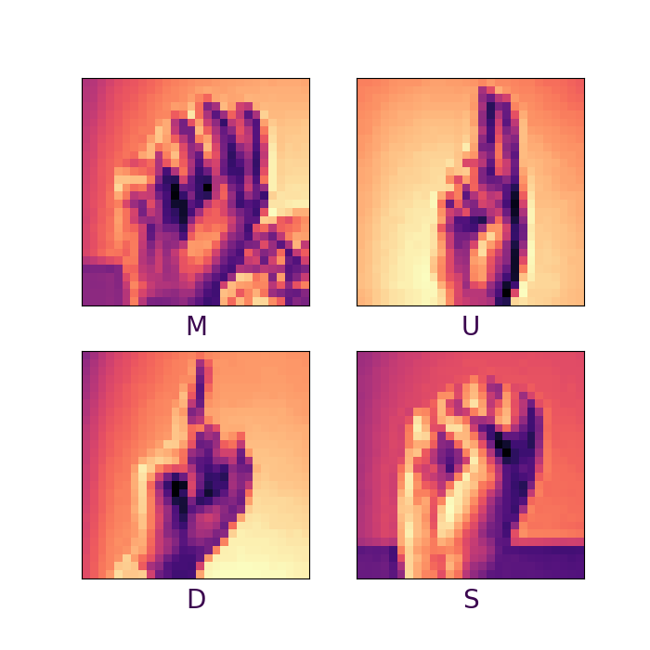
Sign Hand Gesture Recognition
by Artificial Neural Network
Ryan X & Lifeng Q

Slide 2
Model Definition
Extensions
Workshop Overview
Coding Practice
Problem Scope
Training

Slide 3
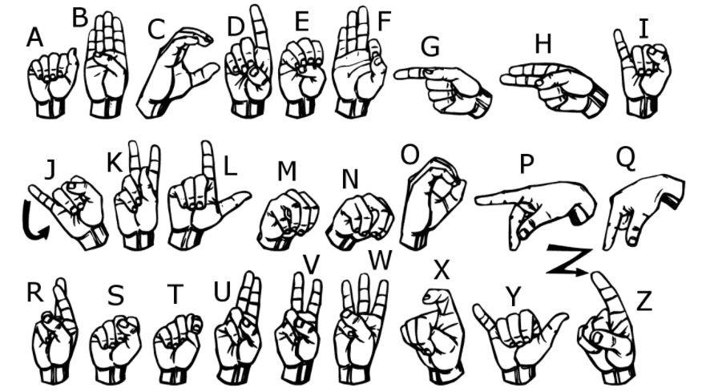
USA Sign Language
Notes:
American Sign Language (ASL) is a complete, natural language that has the same linguistic properties as spoken languages, with grammar that differs from English. ASL is expressed by movements of the hands and face.
The major communication method for deaf or hard-of-hearing disabilities. Nowadays computers can do complex computations on human’s natural languages, like translation and speech recognition. But can computers understand such sign language as well?

Slide 4
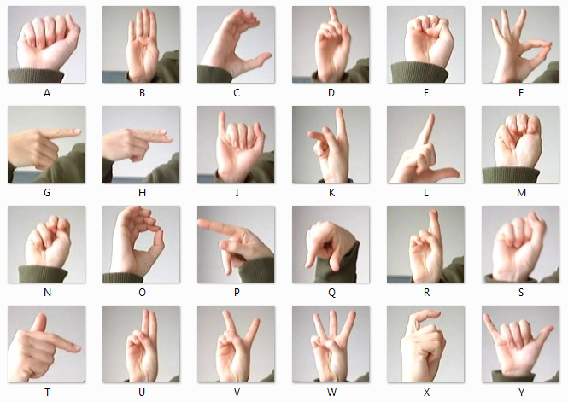
Sign MNIST Dataset
letter A-Z (no cases for 9=J or 25=Z)
28 x 28
27,455 Training Samples
7172 Testing Samples

Slide 5
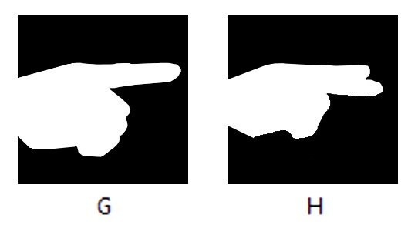
Sign MNIST Dataset

Slide 6
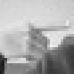
Model Input
28
784
28
···

Slide 7
Model Output
Input
Output
0
2
1
0
0
0
0
0
0
0
1
0
0
0
24 Classes
0~23
One-hot Vector
···
···
···

Slide 8
Model Output
Input
Output
784
24
···
···

Slide 9

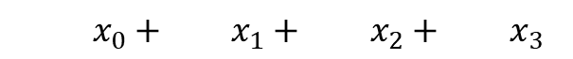


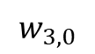


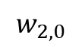
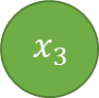
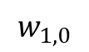
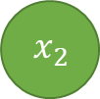
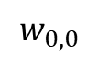
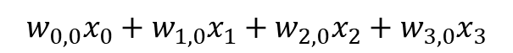
Prediction
Input
Output
$$x_{0}$$
$$w_{0,0}$$
$$y_{0}$$
$$w_{0,0}x_{0}+w_{1,0}x_{1}+w_{2,0}x_{2}+w_{3,0}x_{3}$$
$$w_{1,0}$$
$$w_{0,0}x_{0}+w_{1,0}x_{1}+w_{2,0}x_{2}+w_{3,0}x_{3}$$
$$x_{1}$$
$$w_{2,0}$$
$$y_{1}$$
$$x_{2}$$
$$w_{3,0}$$
$$y_{2}$$
$$x_{3}$$
···
···

Slide 10


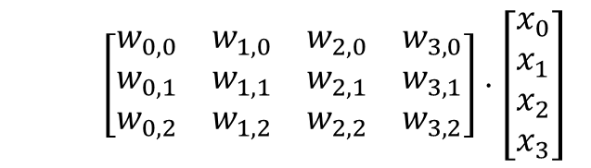
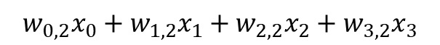
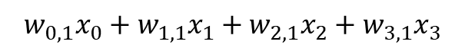
Prediction
$$M=\left[\begin{matrix}w_{0,0} & w_{1,0} & w_{2,0} & w_{3,0} \\ w_{0,1} & w_{1,1} & w_{2,1} & w_{3,1} \\ w_{0,2} & w_{1,2} & w_{2,2} & w_{3,2}\end{matrix}\right]⋅\left[\begin{matrix}x_{0} \\ x_{1} \\ x_{2} \\ x_{3}\end{matrix}\right]$$
Input
Output
$$x_{0}$$
$$y_{0}$$
$$w_{0,0}x_{0}+w_{1,0}x_{1}+w_{2,0}x_{2}+w_{3,0}x_{3}$$
$$x_{1}$$
$$y_{1}$$
$$w_{0,1}x_{0}+w_{1,1}x_{1}+w_{2,1}x_{2}+w_{3,1}x_{3}$$
$$x_{2}$$
$$y_{2}$$
$$w_{0,2}x_{0}+w_{1,2}x_{1}+w_{2,2}x_{2}+w_{3,2}x_{3}$$
$$x_{3}$$
···
···

Slide 11
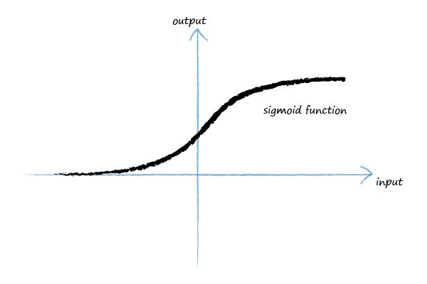
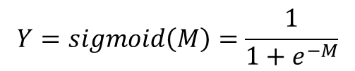
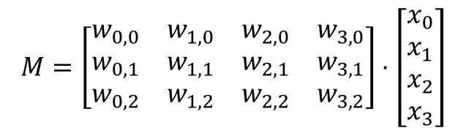
Prediction
$$M=\left[\begin{matrix}w_{0,0} & w_{1,0} & w_{2,0} & w_{3,0} \\ w_{0,1} & w_{1,1} & w_{2,1} & w_{3,1} \\ w_{0,2} & w_{1,2} & w_{2,2} & w_{3,2}\end{matrix}\right]⋅\left[\begin{matrix}x_{0} \\ x_{1} \\ x_{2} \\ x_{3}\end{matrix}\right]$$
Input
Output
$$x_{0}$$
$$y_{0}$$
$$x_{1}$$
$$y_{1}$$
$$x_{2}$$
$$y_{2}$$
$$x_{3}$$
$$Y=sigmoid\left(M\right)=\frac{1}{1+e^{−M}}$$
···
···

Slide 12



Prediction
Input
Hidden
Output
$$x_{0}$$
$$h_{0}$$
$$y_{0}$$
$$x_{1}$$
$$h_{1}$$
$$y_{1}$$
$$x_{2}$$
$$h_{2}$$
$$y_{2}$$
$$x_{3}$$
···
···
···

Slide 13






Prediction
Input
Hidden
Hidden2
Output
$$x_{0}$$
$$h_{0}$$
$$h_{0}^{′}$$
$$y_{0}$$
$$x_{1}$$
$$h_{1}$$
$$h_{1}^{′}$$
$$y_{1}$$
$$x_{2}$$
$$h_{2}$$
$$h_{2}^{′}$$
$$y_{2}$$
$$x_{3}$$
···
···
···
···

Slide 14
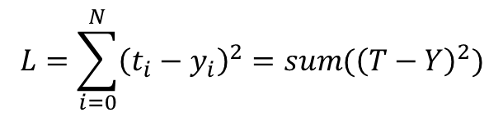



Loss
Output
Target
$$y_{0}$$
$$t_{0}$$
Sum of Square Loss
$$y_{1}$$
$$t_{1}$$
$$L=\sum_{i=0}^{N}{{\left(t_{i}−y_{i}\right)}^{2}}=sum({\left(T−Y\right)}^{2})$$
$$y_{2}$$
$$t_{2}$$
···
···

Slide 15
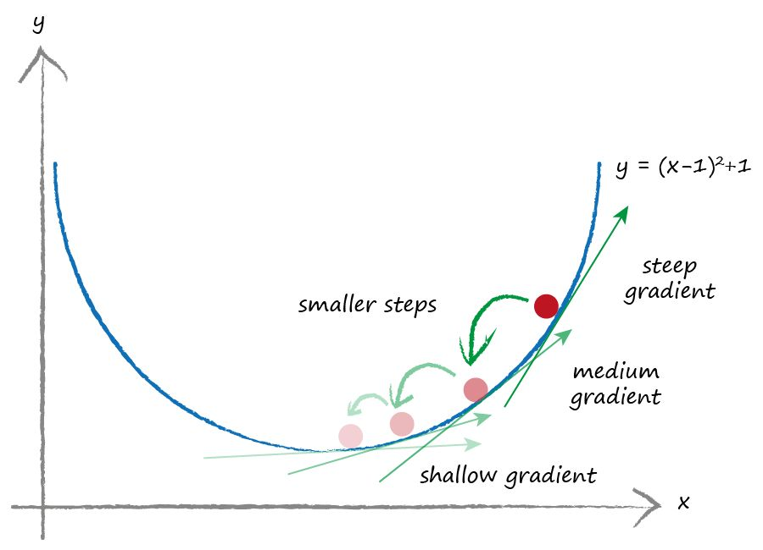
Minimise Loss – Update Weights by Gradient Descent

Slide 16
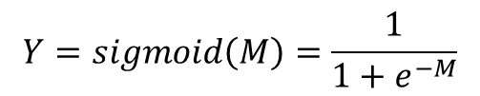
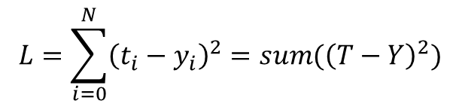
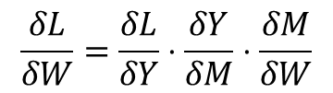
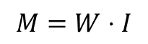
Compute Gradient
$$L=\sum_{i=0}^{N}{{\left(t_{i}−y_{i}\right)}^{2}}=sum({\left(T−Y\right)}^{2})$$
Chain Rule
$$Y=sigmoid\left(M\right)=\frac{1}{1+e^{−M}}$$
$$\frac{δL}{δW}=\frac{δL}{δY}⋅\frac{δY}{δM}⋅\frac{δM}{δW}$$
$$M=W⋅I$$
Do we really need to compute it?
No!

Slide 17

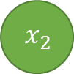














Chain Rule & Backpropagation
Input
Hidden1
Hidden2
Output
Target
$$x_{0}$$
$$h_{0}$$
$$h_{0}^{′}$$
$$y_{0}$$
$$t_{0}$$
$$x_{1}$$
$$h_{1}$$
$$h_{1}^{′}$$
$$y_{1}$$
$$t_{1}$$
$$x_{2}$$
$$h_{2}$$
$$h_{2}^{′}$$
$$y_{2}$$
$$t_{2}$$
$$x_{3}$$
$$\frac{δM_{0}}{δW_{0}} ⋅ \frac{δH_{1}}{δM_{0}} ⋅ \frac{δM_{1}}{δH_{1}} ⋅ \frac{δH_{2}}{δM_{1}} ⋅ \frac{δM_{2}}{δH_{2}} ⋅ \frac{δY}{δM_{2}} ⋅ \frac{δL}{δY} = \frac{δL}{δW_{0}}$$

Slide 18






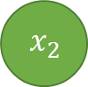
Notice and Improvement
Input
Hidden
Output
Input normalisation
Weights initialisation
Why not all zero / same values?
$$x_{0}$$
$$h_{0}$$
$$y_{0}$$
$$x_{1}$$
$$h_{1}$$
$$y_{1}$$
$$x_{2}$$
Add bias
SoftMax
Cross Entropy Loss
$$h_{2}$$
$$y_{2}$$
$$x_{3}$$
···
···
···

Slide 19
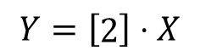
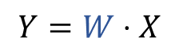
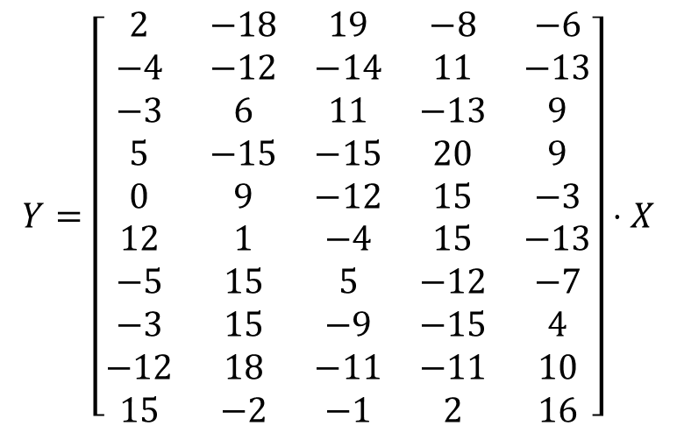
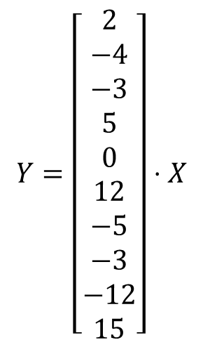
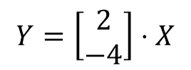
Extension - Unexplainable
$$Y=\left[\begin{matrix}2 & −18 & 19 & −8 & −6 \\ −4 & −12 & −14 & 11 & −13 \\ −3 & 6 & 11 & −13 & 9 \\ 5 & −15 & −15 & 20 & 9 \\ 0 & 9 & −12 & 15 & −3 \\ 12 & 1 & −4 & 15 & −13 \\ −5 & 15 & 5 & −12 & −7 \\ −3 & 15 & −9 & −15 & 4 \\ −12 & 18 & −11 & −11 & 10 \\ 15 & −2 & −1 & 2 & 16\end{matrix}\right]⋅X$$
$$Y=\left[\begin{matrix}2 \\ −4 \\ −3 \\ 5 \\ 0 \\ 12 \\ −5 \\ −3 \\ −12 \\ 15\end{matrix}\right]⋅X$$
$$Y=\left[\begin{matrix}2 \\ −4\end{matrix}\right]⋅X$$
$$Y=\left[\begin{matrix}2\end{matrix}\right]⋅X$$
$$Y=W⋅X$$

Slide 20
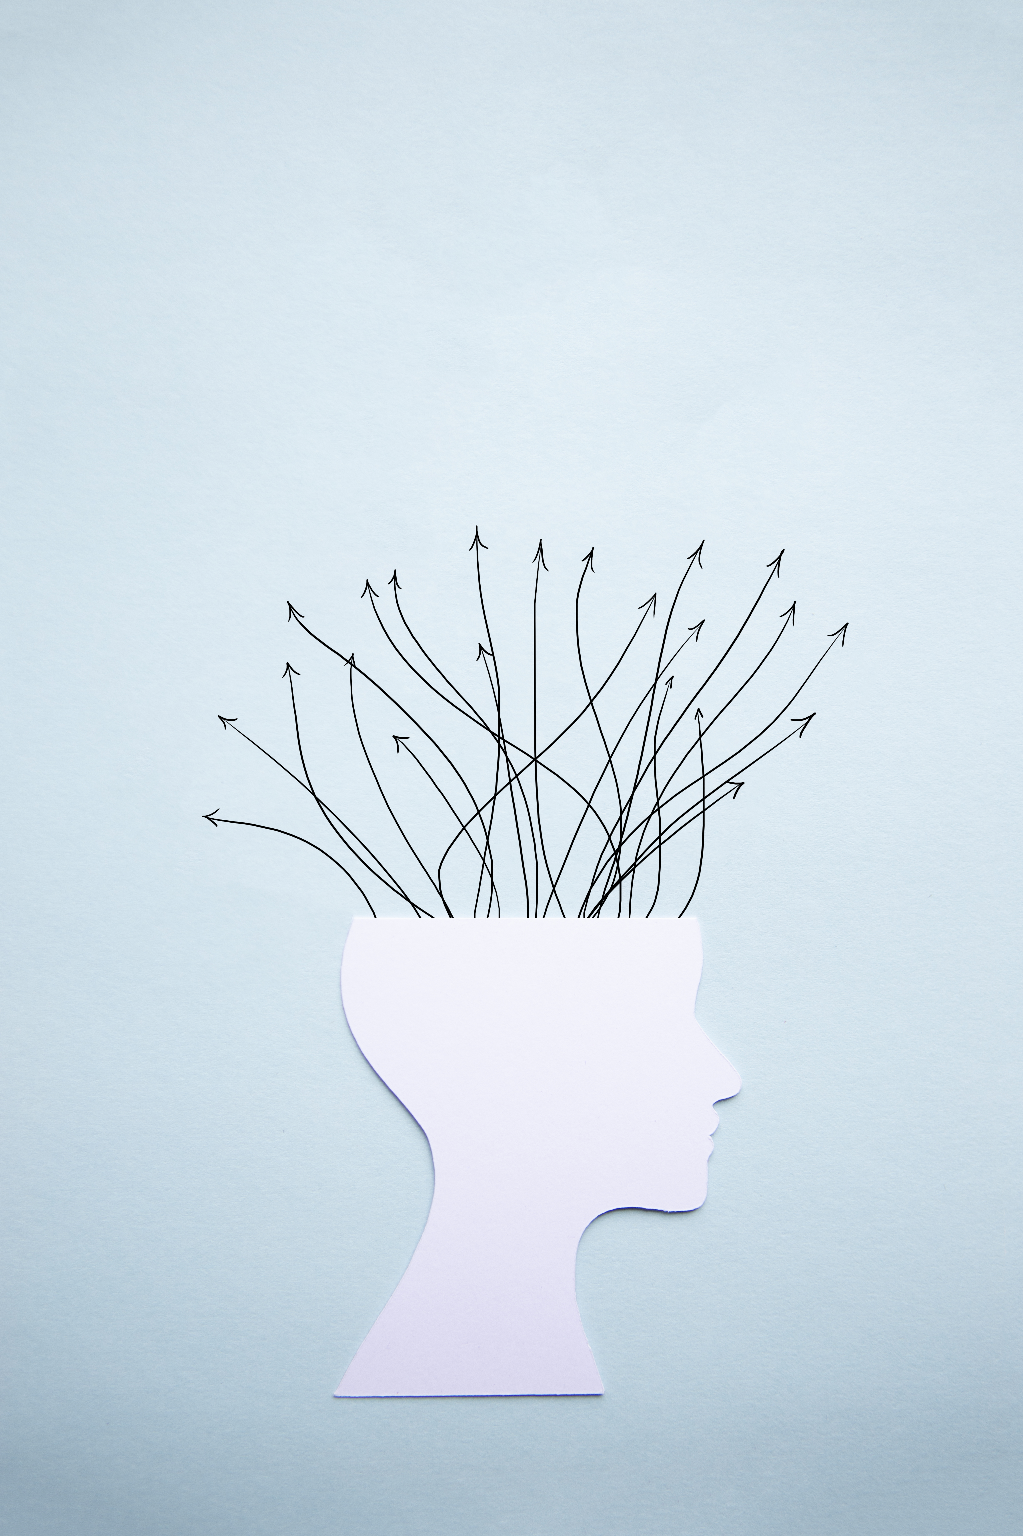
Extension - Universal Approximation
Neural networks can represent a wide variety of interesting functions when given appropriate weights.
It is capable of approximating any continuous functions between two Euclidean spaces, as long as having enough depths and nodes.

Slide 21
Let’s do some coding
bit.ly/MUDS-ANN

Slide 22
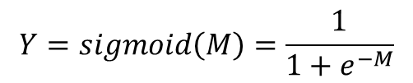
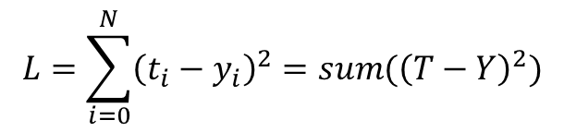
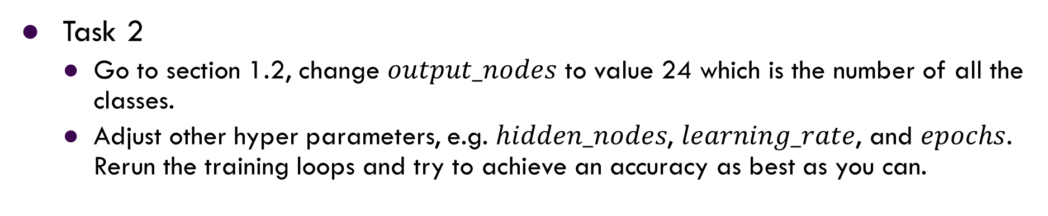
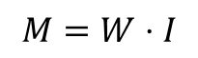
Let’s do some coding
bit.ly/MUDS-ANN
Task 1
Go to section 1.4 and 1.5, replace missing codes “…” with the correct ones.
$$L=\sum_{i=0}^{N}{{\left(t_{i}−y_{i}\right)}^{2}}=sum({\left(T−Y\right)}^{2})$$
$$Y=sigmoid\left(M\right)=\frac{1}{1+e^{−M}}$$
$$M=W⋅I$$
Task 2
Go to section 1.2, change $output_nodes$ to value 24 which is the number of all the classes.
Adjust other hyper parameters, e.g. $hidden_nodes$, $learning_rate$, and $epochs$. Rerun the training loops and try to achieve an accuracy as best as you can.

Slide 23
Thank you!

